Slide 1
Neural Nets II
Notes:
This module continues our discussion of neural nets.

Slide 2
Goals
Recognize feedforward architectures
Derive backpropagation
Optimize weights
Apply backpropagation
Notes:
The learning objectives in this module are at the heart of neural net theory and practice.

Slide 3
Learning and Intro to Neural Nets
Multilayered: Learning Steps
Derivation of Backpropagation
Notes:
In this section we review the parts of a feedforward neural net with one hidden layer.

Slide 4
Neural Nets for Learning
Given: set of input/output vector pairs
e.g. (16.2 , -1.34 , 112.3 ), (7.0 , -3.0 )
Required: a net which yields these results
or, almost—within pre-selected error
Error = √[(o₁ – t₁)² + (o₂ – t₂)² + … + (o_{k} – t_{k})²]
Method: adjust weights
three steps
Notes:
Let’s take the example of a single input/output training datum (16.2 , -1.34 , 112.3 ), (7.0 , -3.0 ). We want values for weights so that the net produces output 7.0 and -3.0 when given input 16.2 , -1.34 , and 112.3. Usually, we are satisfied if the net comes “close enough.” This is usually done by specifying an acceptable amount for the mean square error. The latter is √[(o₁ – t₁)² + (o₂ – t₂)²] for the example with two outputs.
The square form is used because a simple measure such as [|o₁ – t₁| + |o₂ – t₂|] / 2 is not differentiable.
Now we turn our attention to how the weights are adjusted.

Slide 5
Learning Step 1
Specify an acceptable error target.
Assign random weights (typically uniformly distributed, usually within a range)
2.1
- 2.2
0.3
-0.2
16.2
-1.34
112.3
Notes:
The first step is to start with random set of weights, usually bounded (e.g., by -1 and 1). In TensorFlow, this is done using
random_uniform(shape, minval=0, maxval=None, dtype=tf.float32, seed=None, name=None)*
As in W = tf.Variable(tf.random_uniform([9, 6], -1, 1), name=“W”)
* https://www.tensorflow.org/api_docs/python/tf/random_uniform

Slide 6
Weight Initialization in TensorFlow
W_lo = tf.Variable(tf.random_uniform([3, 3], -1, 1), name="WL") W_hi = tf.Variable(tf.random_uniform([2, 3], -1, 1), name="WH")
init_op = tf.initialize_all_variables() sess = tf.Session() sess.run(init_op)
Notes:
Here, W_lo refers to the three weight triples on edges entering the three hidden nodes.

Slide 7
Learning Step 2
Compute square error (or mean sq. root)
e.g., ( 2.1 - 7)² + ( -2.2 - -3 )²
IF within error tolerance
stop
ELSE
find current derivatives of error with respect to weights
(commonly from the backpropagation method)
Notes:
The next learning step is to compute the error (either as a sum of squares or as the square root of the latter). If this happens to produce the desired result, the process is done.
Otherwise, compute the derivative (rate of change) of the error with respect to each of the weights. For example, de/dw₁₂ = -5 and de/dw₂₃ = 4 indicates that the error is decreasing 5 units per unit increase in w₁₂ and increasing 4 units per unit increase in w₂₃.

Slide 8
Gradient Descent
error
Slope is ∂e/ ∂w_{ji}
weight w_{ji}
Notes:
You can visualize the error as a separate function of each w_{ij}, as in the graph. Strictly speaking, since the error e is a function of many variables, we should use the partial derivative sign ∂ rather than “d”.

Slide 9
Learning Step 3 ...
Adjust weights according to a schedule
Repeat the above
Notes:
Now we raise or lower each weight accordingly, in order to reduce the error, and repeat the process until the error is with the acceptable bound.
Performing this process effectively is the subject of much discussion, which we will pursue later. Also, we should understand where backpropagation comes from, given its importance in this field.

Slide 10
Learning and Intro to Neural Nets
Multilayered: Learning Steps
Derivation of Backpropagation
Notes:
In this section we review the parts of a feedforward neural net with one hidden layer.

Slide 11
Neural Nets Are Functions
o₁ vs. t₁
o₁₂ vs. t₂
y = x →
w_{u1}
w_{v2}
w_{u2}
w_{v1}
logistical, k=7 →
u
v
w_{s1}
w_{r2}
w_{s2}
w_{r1}
straight line →
s
r
Notes:
Let’s write the error function explicitly for output (o₁, o₂) and target (t₁, t₂):
e = √[(o₁ – t₁)² + (o₂ – t₂)²]
= √[(i_{1o} – t₁)² + (i_{2o} – t₂)²] where (i_{1o} , i_{2o}) is the total input to the two top nodes
= √[(w_{u1}o_{u} + w_{v1}o_{v} – t₁)² + (w_{u2}o_{u} + w_{v2}o_{v} – t₂)²]
where (o_{u} , o_{v}) is the output from the two hidden nodes
= √[ (w_{u1} / (1 + exp(-7i_{u}) + w_{v1} / (1 + exp(-7i_{v}) – t₁))²
+ (w_{u2} / (1 + exp(-7i_{u}) + w_{v2} / (1 + exp(-7i_{v}) – t₂))² ]
where (i_{u} , i_{v}) is the input to the two hidden nodes
= √[(w_{u1} / (1 + exp(-7(w_{s1}o_{s} + w_{r1}o_{t}) + w_{v1} / (1 + exp(-7(w_{s2}o_{s} + w_{r2}o_{t})) – t₁))²
+ (w_{u2} / (1 + exp(-7(w_{s1}o_{s} + w_{r1}o_{t})) + w_{v2} / (1 + exp(-7(w_{s2}o_{s} + w_{r2}o_{t})) – t₂))²]
where (o_{s} , o_{t}) is the output from the two hidden nodes
= √[(w_{u1} / (1 + exp(-7(w_{s1}i_{s} + w_{r1}i_{t}) + w_{v1} / (1 + exp(-7(w_{s2}i_{s} + w_{r2}i_{t})) – t₁))²
+ (w_{u2} / (1 + exp(-7(w_{s1}i_{s} + w_{r1}i_{t})) + w_{v2} / (1 + exp(-7(w_{s2}i_{s} + w_{r2}i_{t})) – t₂))²]
where (i_{u} , i_{v}) is the input to thre neural net

Slide 12
The Error Explicitly
o₁ vs. t₁
o₁₂ vs. t₂
e = √[(o₁ – t₁)² + (o₂ – t₂)²]
= √[(i_{1o} – t₁)² + (i_{2o} – t₂)²] where (i_{1o} , i_{2o}) is the total input to the two top nodes
= √[(w_{u1}o_{u} + w_{v1}o_{v} – t₁)² + (w_{u2}o_{u} + w_{v2}o_{v} – t₂)²]
where (o_{u} , o_{v}) is the output from the two hidden nodes
w_{u1}
w_{v2}
w_{u2}
w_{v1}
u
v

Slide 13
The Error Explicitly
= √
[
(w_{u1} / (1 + exp(-7i_{u}) + w_{v1} / (1 + exp(-7i_{v}) – t₁))²
+ (w_{u2} / (1 + exp(-7i_{u}) + w_{v2} / (1 + exp(-7i_{v}) – t₂))²
]
where (i_{u} , i_{v}) is the input to the two hidden nodes
u
v

Slide 14
Example of Derivative w.r.t. w_{s2}
v
This is as if differentiating the following
= √[
( k₁ + k₂ / (1 + exp(-7(w_{s2}k₃ + k₄)) – k₅) )² +
( k₆ + k₇ / (1 + exp(-7(w_{s2}k₈ + k₉)) – k₁₀) )²
]
w_{s2}
s
Notes:
Terms not containing w_{s2} might as well be constants, so the expression to be differentiated has the form in the figure. This is not a difficult differentiation.
However, it is better to not try for a single expression in general—and best left to machines (and this for a simple neural net!).

Slide 15
Chain Rule Review
∂v = ∂v. ∂u
∂x ∂u ∂x
Notes:
A principal tool for carrying out the differentiation is the chain rule, which transfers a derivative to another variable. Its practical use is that if you can’t find a derivative with respect to the required variable, you may differentiate with respect to one that is available.

Slide 16
Chain Rule Review
∂v = ∂v. ∂u
∂x ∂u ∂x
Want: dv/dx, where v = x⁶—which we know is 6x⁵
Use chain rule instead as a demonstration:
(2) The problem is same as d(u²)/dx where u = x³
dv/dx
= (dv/du)(du/dx) using chain rule formula
= ( 2u )( 3x² ) = 6x⁵
Notes:
This is an example to illustrate the chain rule. It shows that you get the same result if you differentiate x⁶ directly that you get when you treat x⁶ as u² where u = x³.

Slide 17
Chain Rule Review
∂ v(y,z) = ∂v . ∂y + ∂v . ∂z
∂x ∂y ∂x ∂z ∂x
e.g., v = yz and y = x³, and z = x²
⁽so actually, v = x⁵, and we know dv/dx = 5x⁴
Using the chain rule above instead,…
Notes:
This is the chain rule for a function v of two variables.

Slide 18
Chain Rule Review
∂ v(y,z) = ∂v . ∂y + ∂v . ∂z
∂x ∂y ∂x ∂z ∂x
(dv/dy)(dy/dx) + (dv/dz)(dz/dx)
= ( z )( 3x² ) + ( y )( 2x )
= ( x² )( 3x² ) + ( x³ )( 2x )
= 3x⁴ + 2x⁴
= 5x⁴
Notes:
This is the chain rule for a function v of two variables.

Slide 19
Backpropagation Derivation (1/2)
o_{j}
A method for determining the derivative of the error e w.r.t the weights w_{ji} .
We want ∂e/∂w_{ji}
--where e is the error and w_{ji} is one of the weights.
j
n_{j}
w_{ji}
o_{i}
i
n_{j} = ... + w_{ji} o_{i} + ...
Notes:
We start by focusing on the edge where w_{ij} applies.

Slide 20
Backpropagation Derivation (1/2)
o_{j}
A method for determining the derivative of the error e w.r.t the weights w_{ji} .
∂e/∂w_{ji}= ∂e/∂n_{j} . ∂n_{j}/∂w_{ji}
= - D_{j}. o_{i}
-- labeling - ∂e/∂n_{j} as D_{j}
j
n_{j}
w_{ji}
o_{i}
known
i
n_{j} = ... + w_{ji} o_{i} + ...
Notes:
We can’t find ∂e/∂w_{ji}= ∂e/∂n_{j} . ∂n_{j}/∂w_{ji} directly but we do know ∂e/∂n_{j}—where n_{j} refers to the input to node j, so we use the chain rule in favor of n_{j} as shown.
Notice that we have replaced the search for ∂e/∂w_{ji} by the search for ∂e/∂n_{j} . The quantity n_{j} is higher in the figure than w_{ji}, and this trend of going higher will continue. You might wonder how “going higher” relates to back propagation. That’s because when we are done, we will need to go in reverse to actually evaluate the final expression.

Slide 21
Backprop Derivation continued
o_{j} = f(n_{j} )
j
n_{j}
Notes:
The new task is to determine ∂n_{j}/∂w_{ji}. So we need a formulation of n_{j}.

Slide 22
Backprop Derivation continued
[- D_{j} = ] ∂e/∂n_{j} =
∂e/∂o_{j} . ∂o_{j}/∂n_{j}
= ∂e/∂o_{j} . f’(n_{j} )
(1) If j is an output node:
∂e/∂o_{j} = ∂/∂o_{j} [ 1/2(t_{j} - o_{j})² ] = - (t_{j} - o_{j})
o_{j} = f(n_{j} )
j
known
n_{j}
known
Notes:
The quantity n_{j} is composed of several parts in general.
Assume for now that j is actually an output node. The only part of n_{j} that will not produce zero when differentiating with respect to w_{ji} is from node j—specifically from the output of node j. The quantity o_{j} is produced by the activation function. Also, we use the chain rule again in favor of n_{j}, as shown in the figure, and the derivative of the error relative to w_{ij} is simply - (t_{j} - o_{j})

Slide 23
k
n_{k}
w_{kj}
o_{j}
j
Notes:
But the situation at node j is otherwise as shown.

Slide 24
(2) If j is not an output node:
∂e/∂o_{j} = ∑_{k} [ ∂e/∂n_{k} . ∂n_{k}/∂o_{j} ]
= ∑_{k}
[ ∂e/∂n_{k} . ∂/∂o_{j} ( ... + w_{kj}o_{j + ...} ) ]
= ∑_{k} [ ∂e/∂n_{k} . w_{kj}]
= - ∑_{k} D_{k} .w_{kj}
k
n_{k}
w_{kj}
o_{j}
j
Notes:
Here we use the multiple-variable chain rule to propagate the problem backwards, as shown in the figure. Since the output of node j feeds into several higher nodes, and since those all affect the error, they must all be accounted for in the derivative. This is recursive, since the D_{k} terms must now be computed and this proliferates as the of levels are traversed upwards.

Slide 25
Summary: To Find de/dw_{ji}
1. For each output node j :
∂e/∂w_{ji} = - D_{j} . o_{i}
= f’(n_{j} ) . [-(t_{j} - o_{j})] . o_{i}
[= o_{i} ( o_{j} – t_{j} ) for f: x = y]
o_{j}
Target:
t_{j}
j
n_{j}
w_{ji}
o_{i}
i

Slide 26
Summary: To Find de/dw_{ji}
2. If j is not an output node:
∂e/∂w_{ji} = - D_{j} . o_{i}
= f’(n_{j} ) . [- ∑_{k} D_{k} .w_{kj}] . o_{i}
k
w_{jk}
j
n_{j}
o_{i}
i

Slide 27
Gradient Descent
Error
∂e/∂w_{ji}
Weight w_{ji}
w
w + sf (see next)
Notes:
Focusing on just w_{ij}, the derivative of the error relative to it is a familiar calculus 1 scenario, as shown in the figure. But there is more going on—many w’s and many training pairs.
The error for the complete set of training pairs is the sum of the errors for each pair, so ∂e/∂w_{ji} is actually replaced by ∂(e₁ + e₂ + … e_{n})/∂w_{ji} where e_{i} is the error from pair i. This is just …
∂(e₁)/∂w_{ji} + ∂e₂/∂w_{ji} + … ∂e_{n}/∂w_{ji}
We know how to calculate each of these terms. But this only handles how to change each weight in order to improve the error (unless we overshoot).

Slide 28
Simplest Method
Pick an initial step size s (e.g. 0.1 or 5%)
Pick a reduction method (e.g. a fraction f 10%?)
Compute error on training set
WHILE (error unacceptable)
FOR EACH i, j
Compute all de/dw_{ij} on training set
Change all w_{ij} proportionally by s
s = s*(1-f) // or some other reduction
Recompute error on training set
Notes:
The figure shows a simple method for overall training using the derivative.

Slide 29
Hinton on Backpropagation
https://www.youtube.com/watch?v=46Jzu-xWIBk
Notes:
Few people have done more to advance neural net research than Geoffrey Hinton. Hinton was an early researcher but, more importantly, kept at it when the addition of hidden layers seemed to produce no advances. His seminal paper, “ImageNet Classification with Deep Convolutional Networks”, with Krizhevsky and Sutskever finally showed how to do it, ushering in the idea of “deep learning.”

Slide 30
Other Methods for Gradient Estimation
See textbook
Braude
Differentiate by source code*
Use genetic algorithms
* "Obtaining Sample Path Derivatives by Source Code Instrumentation", Discrete Event Dynamic System: Theory and Applications, 6, 371-378 (1996)
Notes:
There are other ways in which weights can be learned, including some described in the textbook, using Braude’s gradient instrumentation technique for differentiating any computer program, and by using GA’s.

Slide 31
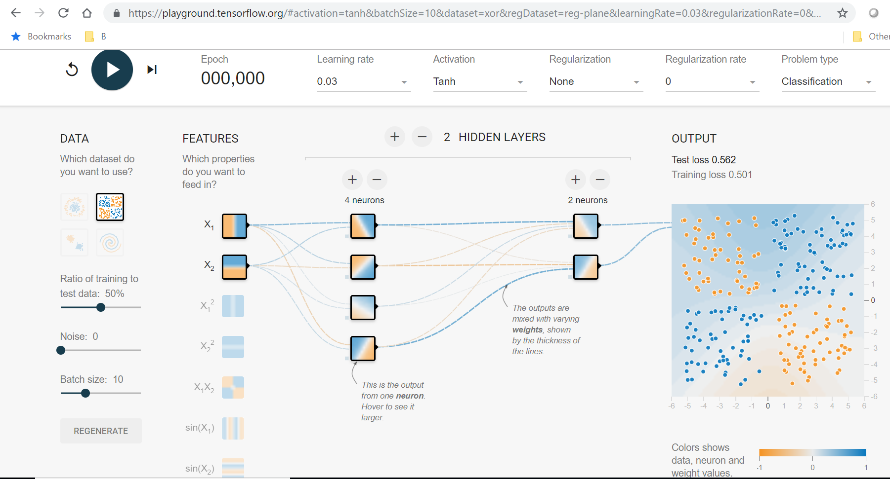
TensorFlow Playground Demo

Slide 32
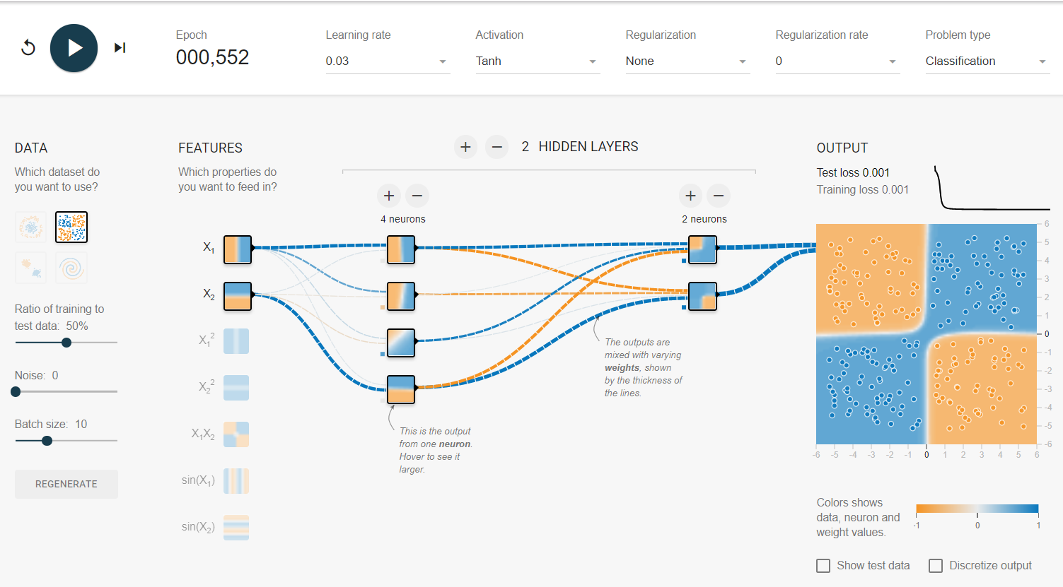
After Training

Slide 33
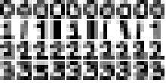
Recognizing 0-3
Four hand-drawn digits. 10 examples of each.
0 1 2 3
Notes:
We will take as example of learning visualization the 4x5 training data shown in the figure.

Slide 34
Example (McMaster’s)
Activation display: The states of the input units are displayed in grey levels on a white background; black means fully activated. The activity levels of the hidden and output units are displayed both numerically, and via a color code ranging from black to red. Bright red means fully on. For the output layer, once a unit's activation level is 0.8 or greater, it is considered to be fully on for the purpose of the display. This feature makes it easier to see when the output units are producing nearly correct responses.
Weight display: The connection weights are displayed in two colors, red squares for positive weights and blue squares for negative weights. The size of the square indicates the magnitude of the weight. For example, a large blue square represents a very large negative coNNection weight. The bias weight of each output unit is displayed in a box just to the left of the unit.

Slide 35
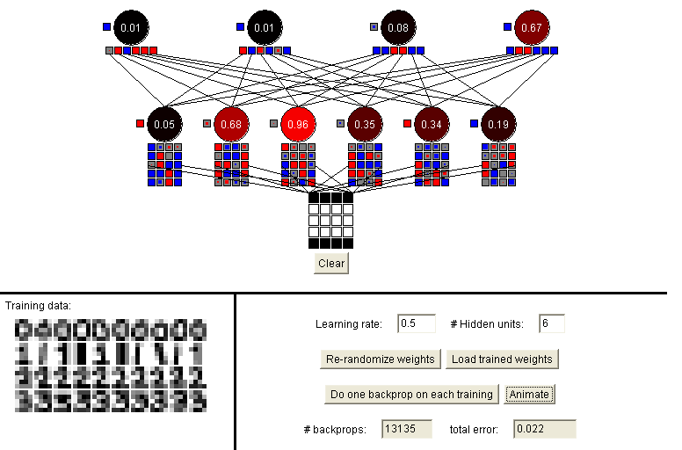
Recognizing 0-3
0
3
Notes:
In this demonstration of learning 0-3 from hand-drawn numbers, there are 4x5 = 20 inputs, each fully connected to 6 hidden nodes (which are expected to learn 6 characteristics), and four outputs. For a particular input, blue indicates a relatively high positive weight and red high negative. The particular example shown activates the hidden node third from the left the most, and favors a recognition as 3 more than 0, 1, or 2.

Slide 36
Summary
Neural Nets are interpolation devices
Use when model not available
Backpropagation very common
based on known input/output data
Slow to learn
dependent on algorithm
Many promising applications
Especially with deep learning

